Slide 1
Radial-Basis Function Networks

Slide 2
Radial-Basis Function Networks
Radial-Basis Function network (RBF) is a three layers architecture:
Input Layer: The input layer is made up of source nodes that connect the network to its environment.
Hidden Layer: In this layer a nonlinear transformation is applied from the input space to the hidden space.
Output Layer: The output layer is linear, supplying the response of the network to the activation pattern applied to the input layer.

Slide 3
Radial-Basis Function Networks
Since Radial basis functions (RBFs) have only one hidden layer, the convergence of optimization objective is much faster, and despite having one hidden layer RBFs are proven to be universal approximators.
RBF networks have many applications like function approximation, interpolation, classification and time series prediction. All these applications serve various industrial interests like stock price prediction, anomaly detection in data, fraud detection in financial transaction etc.
RBF network is an artificial neural network with an input layer, a hidden layer, and an output layer. The Hidden layer of RBF consists of hidden neurons, and activation function of these neurons is a Gaussian function. Hidden layer generates a signal corresponding to an input vector in the input layer, and corresponding to this signal, network generates a response.

Slide 4
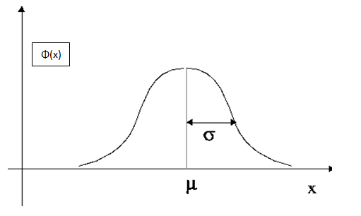

Design and Development
To generate an output, neuron process the input signal through a function called activation function of the neuron. In RBF activation function of hidden neuron is ϕ(X) i.e. for an input vector X output produced by the hidden neuron will be ϕ(X) .

Slide 5

Above figure represents a Gaussian neural activation function for 1-D input x with center (mean) μ .
Here ϕ(x) represents the output of Gaussian node for given value of x. It can be clearly seen that the signal strength decreases as the input (X) move away from the center.
The basic idea of this model is that the entire feature vector space is partitioned by Gaussian neural nodes, where each node generates a signal corresponding to an input vector, and strength of the signal produced by each neuron depends on the distance between its center and the input vector. Also for inputs lying closer in Euclidian vector space, the output signals that are generated must be similar.
Here, μ is center of the neuron and ϕ(X) is response of the neuron corresponding to input X.

Slide 6
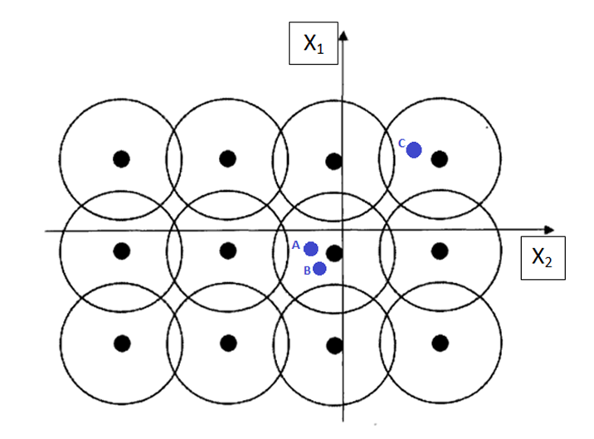
In above figure circles represent Gaussian neural nodes and boundary of circles represents the range of the corresponding nodes also known as the receptive field of neurons.
Here 2-D vector space is partitioned by 12 Gaussian nodes. Every input vector activates the collective system of neurons to some extent and the combination of these activations enables RBF to decide how to respond.
Above configuration of neurons will generate similar output signals for input vectors A and B whereas for C output generated will be quite different.

Slide 7
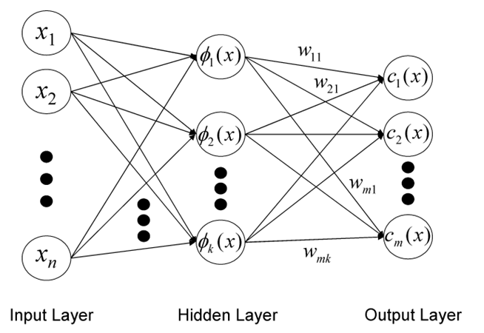
In RBF architecture, weights connecting input vector to hidden neurons represents the center of the corresponding neuron. These weights are predetermined in such a way that entire space is covered by the receptive field of these neurons, whereas values of weights connecting hidden neuron to output neurons are determined to train the network.

Slide 8
It’s appropriate if vectors lying close in the Euclidian space falls under the receptive field of the same neuron; therefore centers of hidden neurons are determined using K-Means clustering.
k Means Clustering algorithm:
Choose the number of cluster centers “K”.
Randomly choose K points from the dataset and set them as K centroids of the data.
For all the points in the dataset, determine the centroid closest to it.
For all centroids, calculate the average of all the points lying closest to the same centroid.
Change the value of all the centroids to corresponding averages calculated in (4).
Go to (3) until convergence.

Slide 9

The range of receptive fields is chosen such that entire domain of input vector is covered by the receptive field of the neurons. So, the value of sigma is chosen according to maximum distance “d” between two hidden neurons.
Where d is the maximum distance between two hidden neurons and M is the number of hidden neurons.

Slide 10
Mathematical Development
Let g_{ij} be an element of matrix G representing the output of j^{th} neuron for i^{th} input vector and W_{ij} be an element of matrix W representing weight connecting i^{th} output neuron to j^{th} hidden neuron.
In RBF, the activation function of output neuron is linear i.e. “ g(z)= z “ where z is the weighted summation of signals from hidden layer. Multiplying i^{th} row of G with j^{th} columns of W does the weighted summation of signals from the hidden layer which is equal to signal produced by j^{th} output neuron.
GW= T
Where T is a column vector and i^{th} row contains the target value (actual desired output) of i^{th} training vector.
From above equation, by method of pseudo inverse
W=(G^{T}G)⁻¹G^{T}T (3)
where G^{T} is the transpose of matrix G.

Slide 11
Algorithm
Define the number of hidden neurons “K”.
set the positions of RBF centers using K-means clustering algorithm.
Calculate σ using equation (2)
Calculate actions of RBF node using equation (1)
Train the output using equation (3)

Slide 12
RBF v/s MLP
MLPs are advantageous over RBFs when the underlying characteristic feature of data is embedded deeply inside very high dimensional data sets.
For example, in image recognition, features depicting the key information about the image is hidden inside tens of thousands of pixel. For such training examples, the redundant features are filtered as the information progress through the stack of hidden layers in MLPs, and as a result, better performance is achieved.
Having only one hidden layer RBFs have much faster convergence rate as compared to MLP. For low dimensional data where deep feature extraction is not required and results are directly correlated with the component of input vectors, then RBF network is usually preferred over MLP. RBFs are universal approximators, and unlike most machine learning models RBF is a robust learning model.

Slide 13
RBF ARCHITECTURE
x₁
One hidden layer with RBF activation functions
Output layer with linear activation function.
w₁
x₂
y
w_{m1}
x_{m}

Slide 14
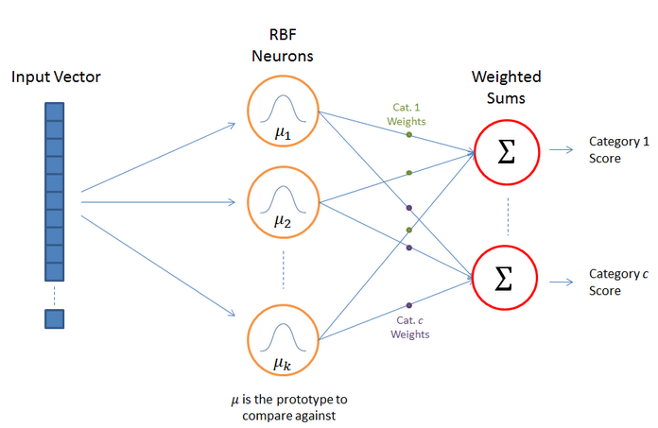
RBF Network Architecture

Slide 15
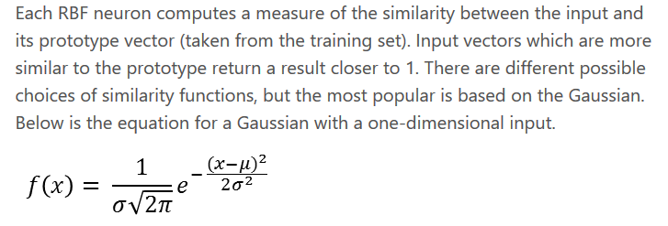
RBF Neuron Activation Function

Slide 16
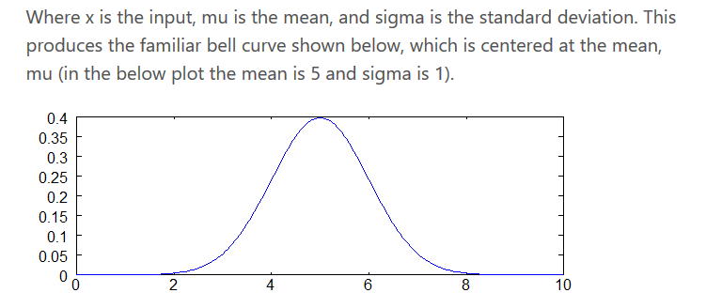

Slide 17
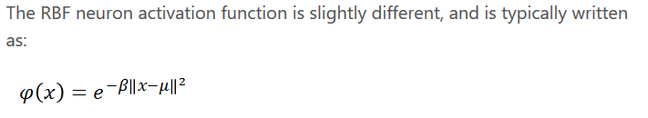
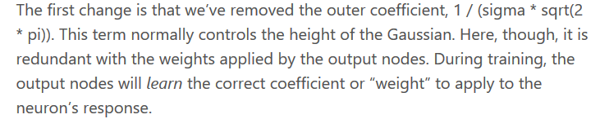
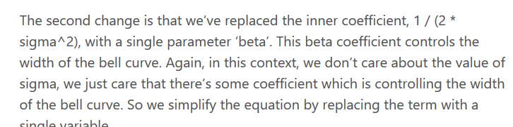
RBF neuron activation function

Slide 18
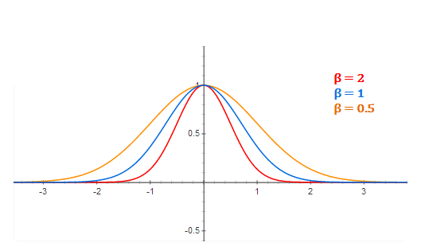
RBF Neuron activation for different values of beta

Slide 19

Training The RBFN

Slide 20
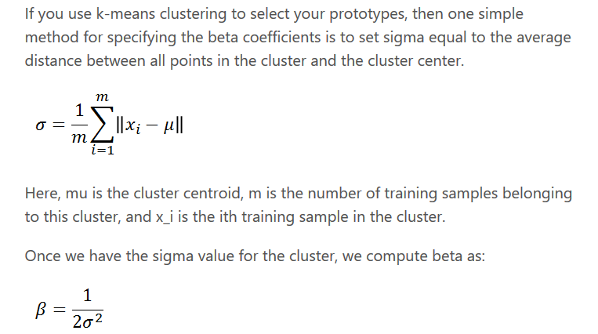
Selecting Beta Values

Slide 21
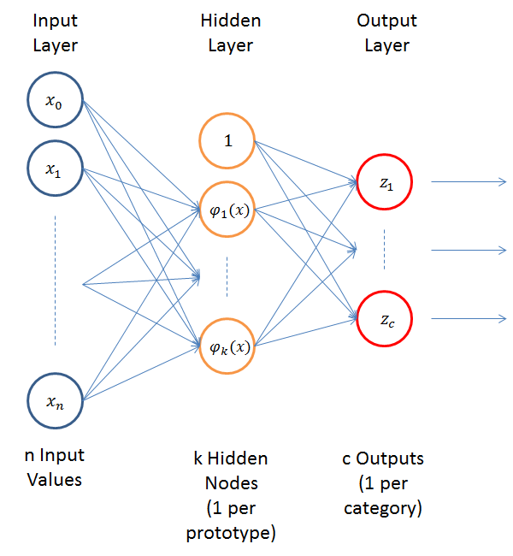
RBFN as a Neural Network

Slide 22
Example: XOR Problem
Input space:
Output space:
Construct an RBF pattern classifier such that:
(0,0) and (1,1) are mapped to 0, class C1
(1,0) and (0,1) are mapped to 1, class C2
x₂
(0,1)
(1,1)
x₁
(0,0)
(1,0)
0
1
y

Slide 23
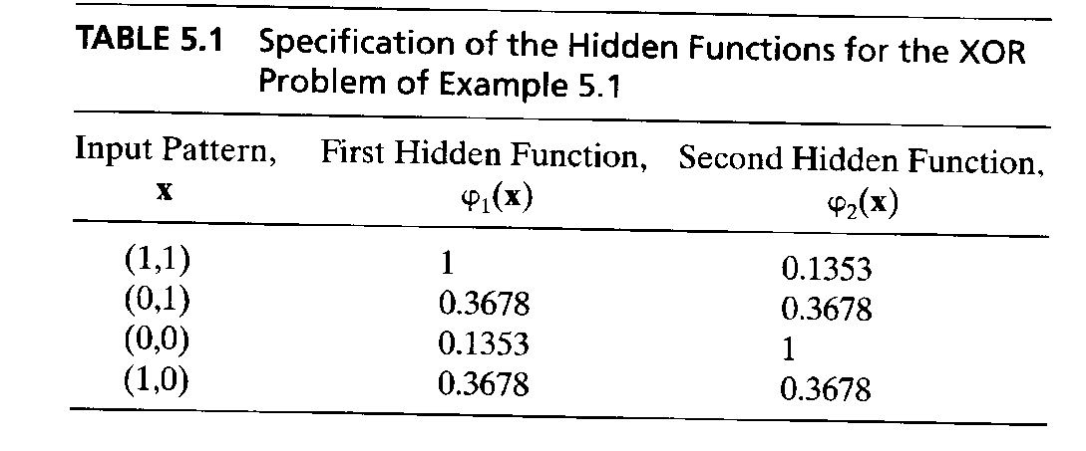
Example: the XOR problem
In the feature (hidden layer) space:
When mapped into the feature space < ϕ₁ , ϕ₂ > (hidden layer), C1 and C2 become linearly separable. So a linear classifier with ϕ₁(x) and ϕ₂(x) as inputs can be used to solve the XOR problem.
φ₂
(0,0)
Decision boundary
1.0
0.5
(1,1)
0.5
1.0
φ₁
(0,1) and (1,0)

Slide 24
RBF NN for the XOR problem
x₁
t1
W1=-1
y
x₂
t2
W2=-1
+1

Slide 25
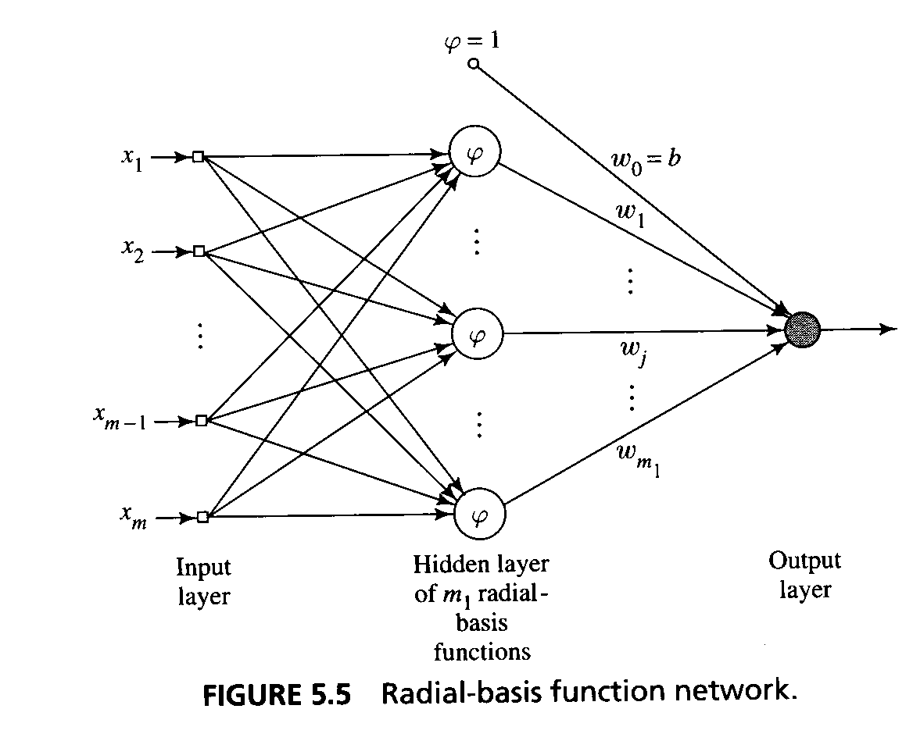
Generalized Radial-Basis Function Networks
When , i=1..N is large, the one-to-one correspondence between the training input data and the Green’s function produces a regularisation network that may be considered expensive.
An approximation of the regularized network.
x_{i}

Slide 26
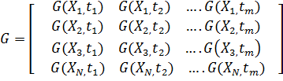

Example: XOR Problem
Table: Input output Transformation Computed for XOR problem
Data point, j | Input pattern, X_{j} | Desired output, d_{j}
1 | (1, 1) | 0
2 | (0,1) | 1
3 | (0,0) | 0
4 | (1,0) | 1
Where G is green’s function defined as:
Calculated as
G(||x - t_{i}||) = exp(- ) i=1,2

Slide 27

W= [w1 w2 b]^{T}
d=[0 1 0 1]^{T}
Where
And is a pseudo inverse of G
x₁
ψ1
W1
y
x₂
ψ2
W2
Input Nodes
b=+1
(bias)
Gaussian function
Thus the final input output relation of the network is defined as:

